Slide 1
Harmonising Cognitive Scores across COSMIC cohorts
Creating comparable cognitive domain and global scores
James Lian, PhD | Centre for Healthy Brain Ageing, UNSW Sydney
Education webinar
Notes:
[0:30] Welcome. In ten minutes: our goal, where we are starting, how harmonisation works, and where the project is up to.

Slide 2
Make cognition comparable
THE GOAL
OUR GOAL
Domain scores
Harmonise cognitive data across COSMIC cohorts to create comparable scores
Memory, executive function, language, visuospatial, orientation
Global cognition
One overall score, where the data allow
Reference framework: HRS-HCAP, as the initial comparison.
Notes:
[1:15] Our goal: harmonise cognitive data from COSMIC cohorts and create comparable cognitive domain scores and global cognition scores. Each cohort tests cognition differently, so today a score in one cohort cannot be compared with another. The reference framework is HRS-HCAP, as a starting point.

Slide 3
Start small: a proof of concept
WHERE WE START
STEP ONE
THEN
Feasibility study with homogeneous cohorts
Scale to wider COSMIC
→
About 3 to 5 cohorts
Australian or WEIRD
Other languages and cultures
More cohorts
Why? Less noise, so we can learn what works first
Notes:
[1:00] We will not begin with all cohorts. We start with Australian and Western English-speaking cohorts, roughly three to five. Shared language and culture remove a major source of noise, so we can test whether the method works before scaling to the wider COSMIC network.

Slide 4
Same construct, different tests
THE CHALLENGE
A
COHORT A
→
Episodic memory?
Word-list recall
All may tap the same ability
but scores are not directly comparable
Different content, range and difficulty
B
COHORT B
→
Story recall
C
COHORT C
→
Picture recall
A raw score of 8 in one cohort is not an 8 in another
Notes:
[1:00] Three cohorts, three memory tests. Each probably taps episodic memory, but content, scoring range and difficulty differ, so a raw score of 8 in one cohort does not mean the same as 8 in another. Matching variable names is not harmonisation.

Slide 5
From items to comparable scores
THE ROADMAP
Conceptual → Statistical
5
4
Validate
3
Model scores
2
Test specific assumptions
Expert review
1
Global and domains where viable
Identify links
Are the links defensible?
Curate items
What can genuinely link?
What exactly was administered?
Notes:
[1:00] Five steps, each answering a different question. Steps one to three are conceptual: what was administered, what can link, are links defensible. Steps four and five are statistical: model the scores and test specific assumptions. We start in the Australian proof of concept.

Slide 6
Decide what can genuinely link
THE CONCEPTUAL STEP
EXAMPLE: EPISODIC MEMORY
EXPERT REVIEW
MAS
RAVLT recall
PATH
CVLT recall
1
Curate
↔
Items, scoring, administration
2
Compare
Both tap memory, but list length, trials, and delay may differ. However, they may share candidate linking items (e.g. immediate recall).
Same domain is not the same link
3
Adjudicate
Experts review uncertain links
Expert judgement proposes. The statistics test it.
Notes:
[1:30] Experts help decide what can link. We curate item, scoring and administration details, compare, then experts adjudicate uncertain links, using Delphi-style rounds where useful, recording decision, confidence and rationale. Example: MAS used the Rey Auditory Verbal Learning Test, PATH used the California Verbal Learning Test. Both are word lists tapping memory, but list length, trials and delay differ, so it is a candidate link until item-level evidence supports it. Details are from published papers; confirm against data dictionaries.

Slide 7
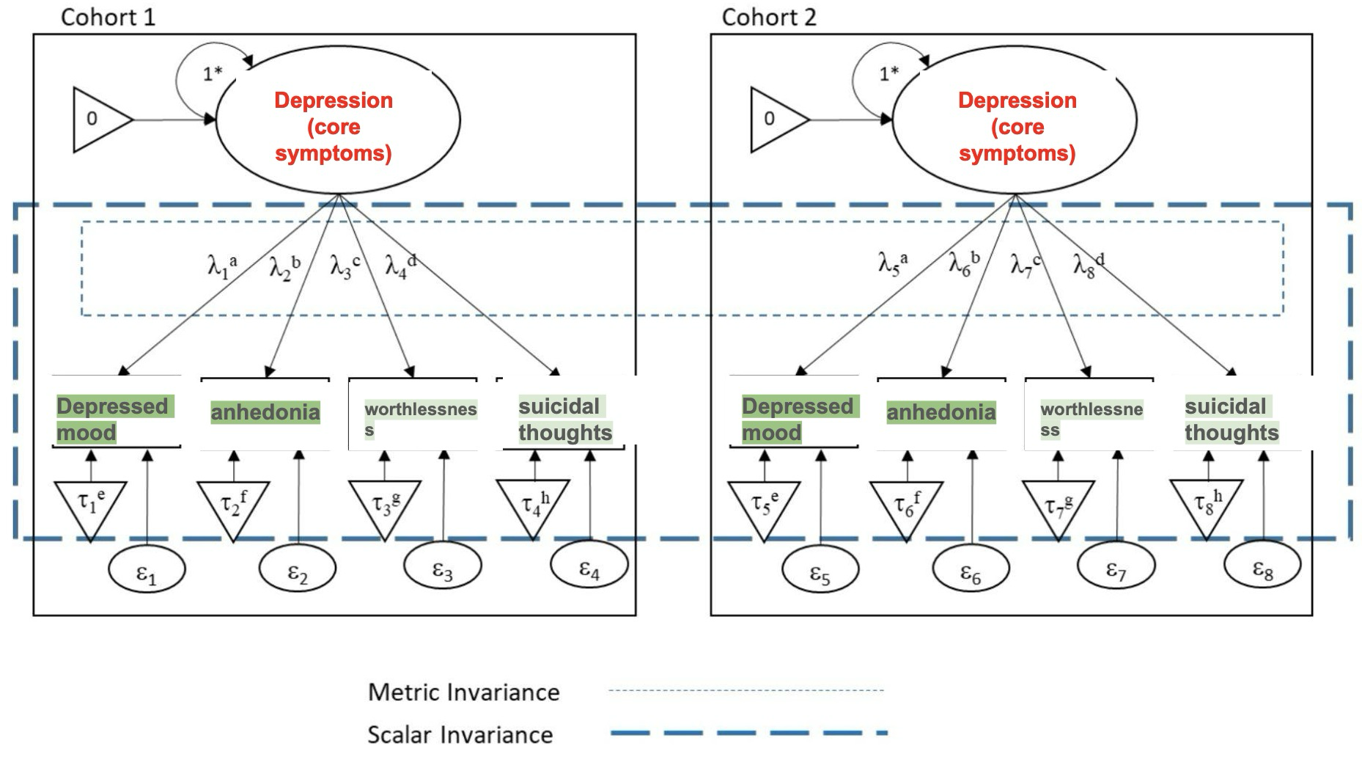
Validating the model
THE STATISTICAL STEP
MGCFA or IRT
Do p’s from different cohorts interpret and respond the same?
Metric invariance: Equal factor scores
Scalar invariance: Equal factor scores + equal intercepts
Notes:
[1:45] Only after the linkage map do we model. Global cognition from all suitable items where cohorts are adequately linked; domain scores where enough defensible links exist; CFA or IRT place linked items on a common scale. Good modelling cannot rescue weak links. Validation tests a specific claim: are the linking decisions defensible, does the network identify a common scale, do DIF and invariance hold where relevant, and do conclusions survive alternative choices.

Slide 8
Where we are and what is next
PROGRESS
DONE SO FAR
NEXT
✓ Framework revised with HCAP input
✓ Decision log and GitHub repository
✓ COSMIC cohorts invited
✓ Item-level curation framework in progress
1 Decide on proof-of-concept cohorts
2 Deep item curation
3 Expert adjudication of links
4 Model, validate, then scale
Take-home: decide what can link first, model the scores second
Notes:
[1:30] Status: framework revised after consultation with HCAP, decision log and GitHub in place, COSMIC cohorts invited, and item-level curation underway. Next: select the proof-of-concept cohorts, do deep item curation beyond data dictionaries, expert adjudication, then model, validate and scale to COSMIC. No harmonised scores yet.

Slide 9
Thank you
Questions and ideas welcome
James Lian, PhD
j.lian@unsw.edu.au
github.com/jameseyjames/cosmic_harmonisation
Notes:
[0:30] Close and invite questions. If your cohort is interested or you have harmonisation experience, please get in touch.

